Slide 1
Chapter 5 Data Path and System Design Issues EXTC – TE – DVLSI Swati Rane Assistant Professor Dept. of Electronics and Telecommunication SIES Graduate School of Technology
DVLSI

Slide 2
Multiplier
Multipliers are used in a wide range of digital signal processing and other applications.
The execution speed of multipliers depends on
semiconductor technology,
multiplier architecture.
The basic building block of digital multipliers – adders - perform a series of repeated additions
To speed up the multiplier operation, the adder’s operation speed has to be increased.
There are many digital signal processing applications, where critical delay path and the performance of the processor lies in the multiplier.
There are different types of multipliers
Booth Multiplier
Combinational Multiplier
Sequential Multiplier
Wallace tree Multiplier
Array Multiplier
Shift and Add Multiplier

Slide 3
Multiplication Algorithm
Multiplication process has three main steps:
Partial product generation
Partial product reduction
Final addition
Partial Products are generated using AND gates, where
Multiplicand = N-bits
Multiplier = M-bits
partial products = N*M.

Slide 4
Steps of Multiplication Algorithm
Steps in Multiplication
If LSB of Multiplier is ‘1’. then add the multiplicand into an accumulator multiplier bit is shifted one bit to the right and multiplicand bit is shifted one bit to the left.
Stop when all bits of the multiplier is zero.
Less hardware is used if partial products are added serially. We can add all PP by a parallel multiplier.
However, it is possible to use compression technique the number of partial products can be reduced before addition, is performed.

Slide 5
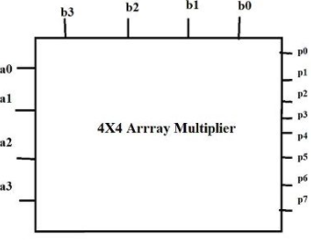
Construction and Working of a 4×4 Array Multiplier
The design structure of the array Multiplier is regular, it is based on the add shift algorithm principle.
Partial product = the multiplicand * multiplier bit
where AND gates are used for the product, the summation is done using Full Adders and Half Adders where the partial product is shifted according to their bit orders.
An n*n array multiplier uses -
n*n AND gates compute the partial products
n* (n – 2) Full adders and n Half adders perform the addition of partial products .
The 4×4 array multiplier shown has 8 inputs and 8 outputs

Slide 6
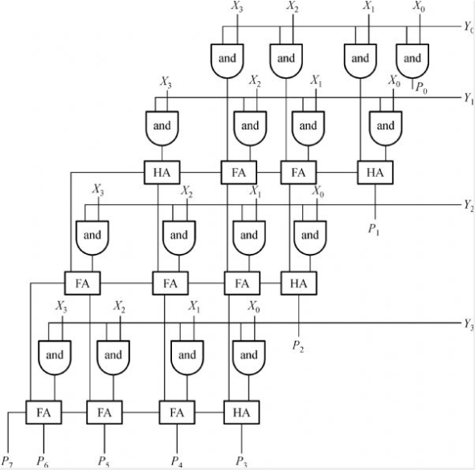
4 X 4 array multiplier
For a 4×4 Array Multiplier, it needs
16 AND gates,
4 Half Adders(HAs),
8 Full Adders (FAs)

Slide 9
4×4 Array Multiplier
Advantages -
Minimum complexity
Easily scalable
Easily pipelined
Regular shape, easy to place and route
Disadvantages -
High power consumption
More digital gates resulting in large areas.
Applications -
Array multiplier is used to perform the arithmetic operation in filtering, Fourier transform, image coding.
High-speed operation.

Slide 10
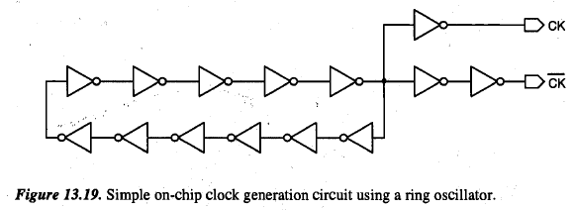
On-Chip Clock Generation and Distribution
Clock signals are the heartbeats of digital systems.
The stability of clock signals is highly important.
Ideally, clock signals should have minimum rise and fall times, specified duty cycles, and zero skew.
In reality, clock signals have nonzero skews and noticeable rise and fall times; duty cycles can also vary.
A simple technique for on-chip generation of a primary clock signal would be to use a ring oscillator.
Such a clock circuit has been used in low-end microprocessor chips.

Slide 11
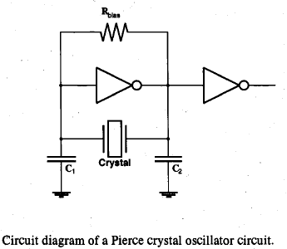
On-Chip Clock Generation
The generated clock signal can be quite process-dependent and unstable.
Hence, a separate clock chips which use crystal oscillators are used for high performance VLSI chip families.
Series resonance exists in the crystal but its internal series resistance largely determines the oscillation frequency. The higher the series resistance, the lower the oscillation frequency.
The external load at the terminals of the crystal also has a considerable effect on the frequency and the frequency stability.
The inverter across the crystal provides the necessary voltage differential, and the external inverter provides the amplification to drive clock loads.

Slide 12
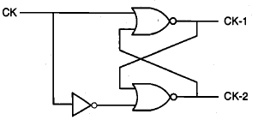
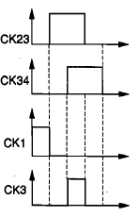
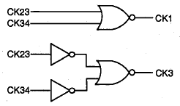
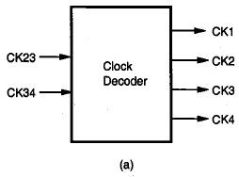
On-Chip Clock Generation
It is often necessary to use two non-overlapping clock signals. The logical product of such two clock signals should be zero at all times.
A simple circuit that generates CK- 1 and CK-2 from the original clock signal CK.
A clock decoder circuit takes in the primary clock signals and generates four phase signals.

Slide 13
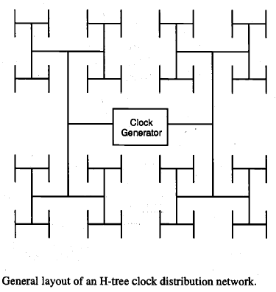
On-Chip Clock Distribution
Since clock signals are required almost uniformly over the chip area, it is desirable that all clock signals are distributed with a uniform delay.
An ideal distribution network would be the H-tree structure.
In such a structure, the distances from the center to all branch points are the same and hence, the signal delays would be the same.
However, this structure is difficult to implement in practice due to routing constraints and different fanout requirements.

Slide 14
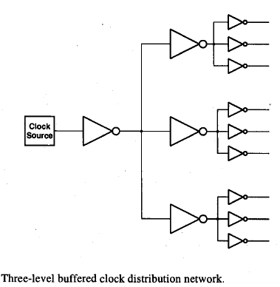
On-Chip Clock Distribution
The reduction of clock skews, which are caused by the differences in clock arrival times and changes in clock waveforms due to variations in load conditions, is a major concern in high-speed VLSI design.
Regardless of the exact geometry of the clock distribution network, the clock signals must be buffered in multiple stages to handle the high fan-out loads.
It is also essential that every buffer stage drives the same number of fan-out gates so that the clock delays are always balanced.

Slide 15
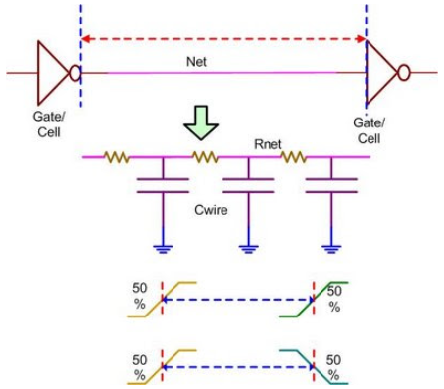
Interconnect Delay
Net delay is the difference between the time a signal is first applied to the net and the time it reaches other devices connected to that net.
It is due to the finite resistance and capacitance of the net. It is also known as wire delay.
Wire delay = function of (Rnet, Cnet+Cpin)
This is output pin of the cell to the input pin of the next cell.

Slide 16
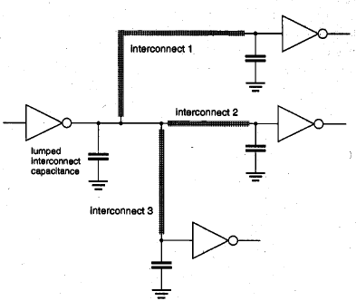
Interconnect Delay
The classical approach for determining the switching speed of a logic gate is based on the assumption that the loads are mainly capacitive and lumped.
The conventional delay estimation approaches seek to classify three main components of the output load, all of which are assumed to be purely capacitive, as:
(i) internal parasitic capacitances of the transistors,
(ii) interconnect (line) capacitances, and
(iii) input capacitances of the fan-out gates.
If the load from each interconnection line can be approximated by a lumped capacitance, then the total load seen by the primary inverter is simply the sum of all capacitive components.
In realistic conditions, the interconnection line is in very close proximity to a number of other lines, either on the same level or on different levels.
The capacitive/inductive coupling and the signal interference between neighboring lines should also be taken into consideration for an accurate estimation of delay.

Slide 17
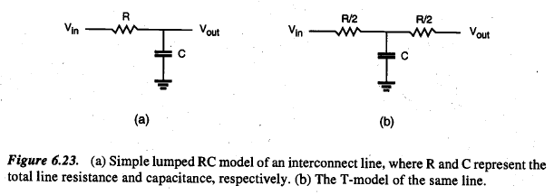
Interconnect Delay
An interconnect line can be modeled as a lumped RC network if the time of flight across the interconnection line is significantly shorter than the signal rise/fall times.

Slide 18
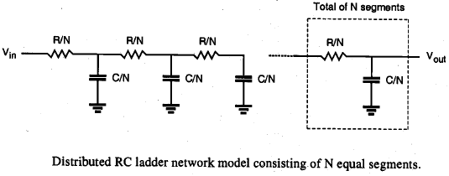
Interconnect Delay
The transient behavior of an interconnect line can be more accurately represented using the RC ladder network.
Here, each RC-segment consists of a series resistance (R/N), and a capacitance (C/N) connected between the node and the ground.
It can be expected that the accuracy of this model increases with increasing N, where the transient behavior approaches that of a distributed RC line for very large values of N.

